Slide 1

Evaluation of Various Sensing Modalities for Accurate Measurement of Neck Flexion Angle during Thyroid and Ear Surgery
CIS II Project
Team Member : Zhen Hu, Hanqing Duan
Mentor: Dr. Russell Taylor, Dr. Deepa Galaiya

Slide 2
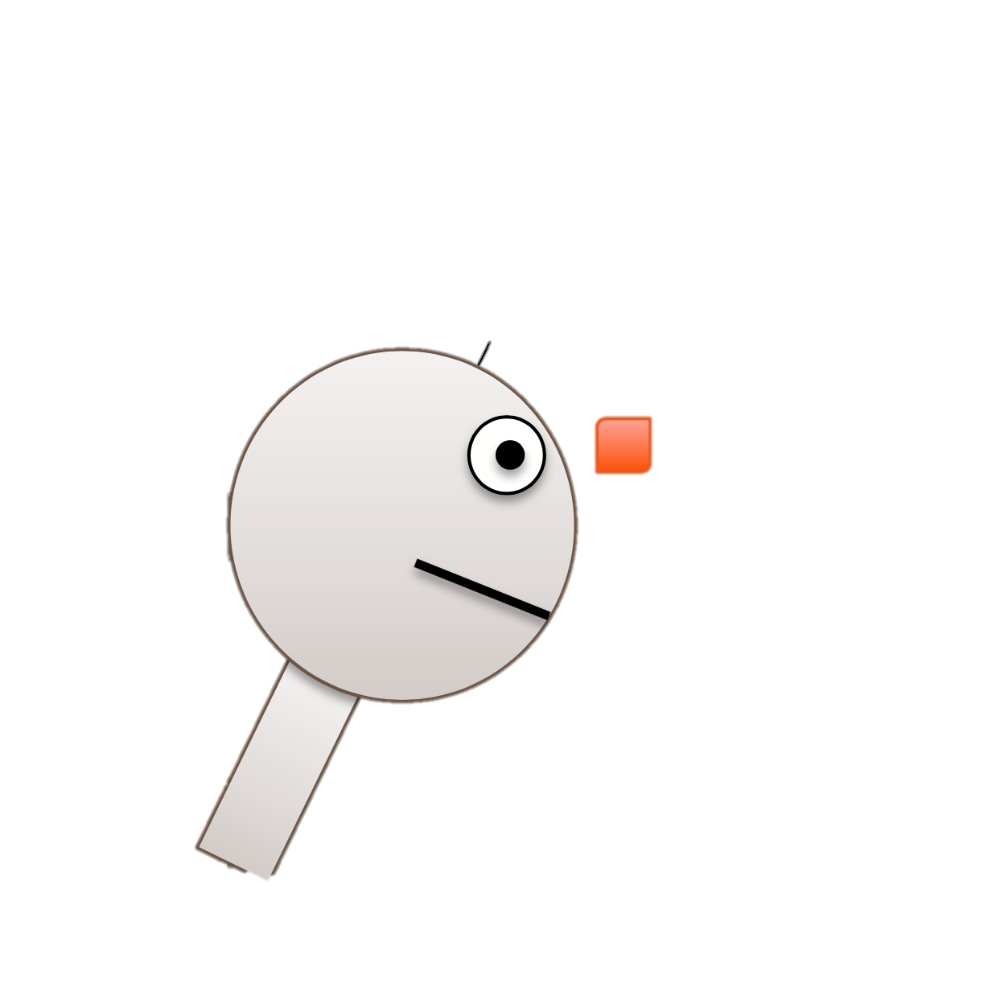
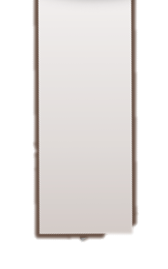


Project Review
Last week:
Collecting the calibration data
Collecting the Mock OR data with the help of Deepa
$$θ$$

Slide 3
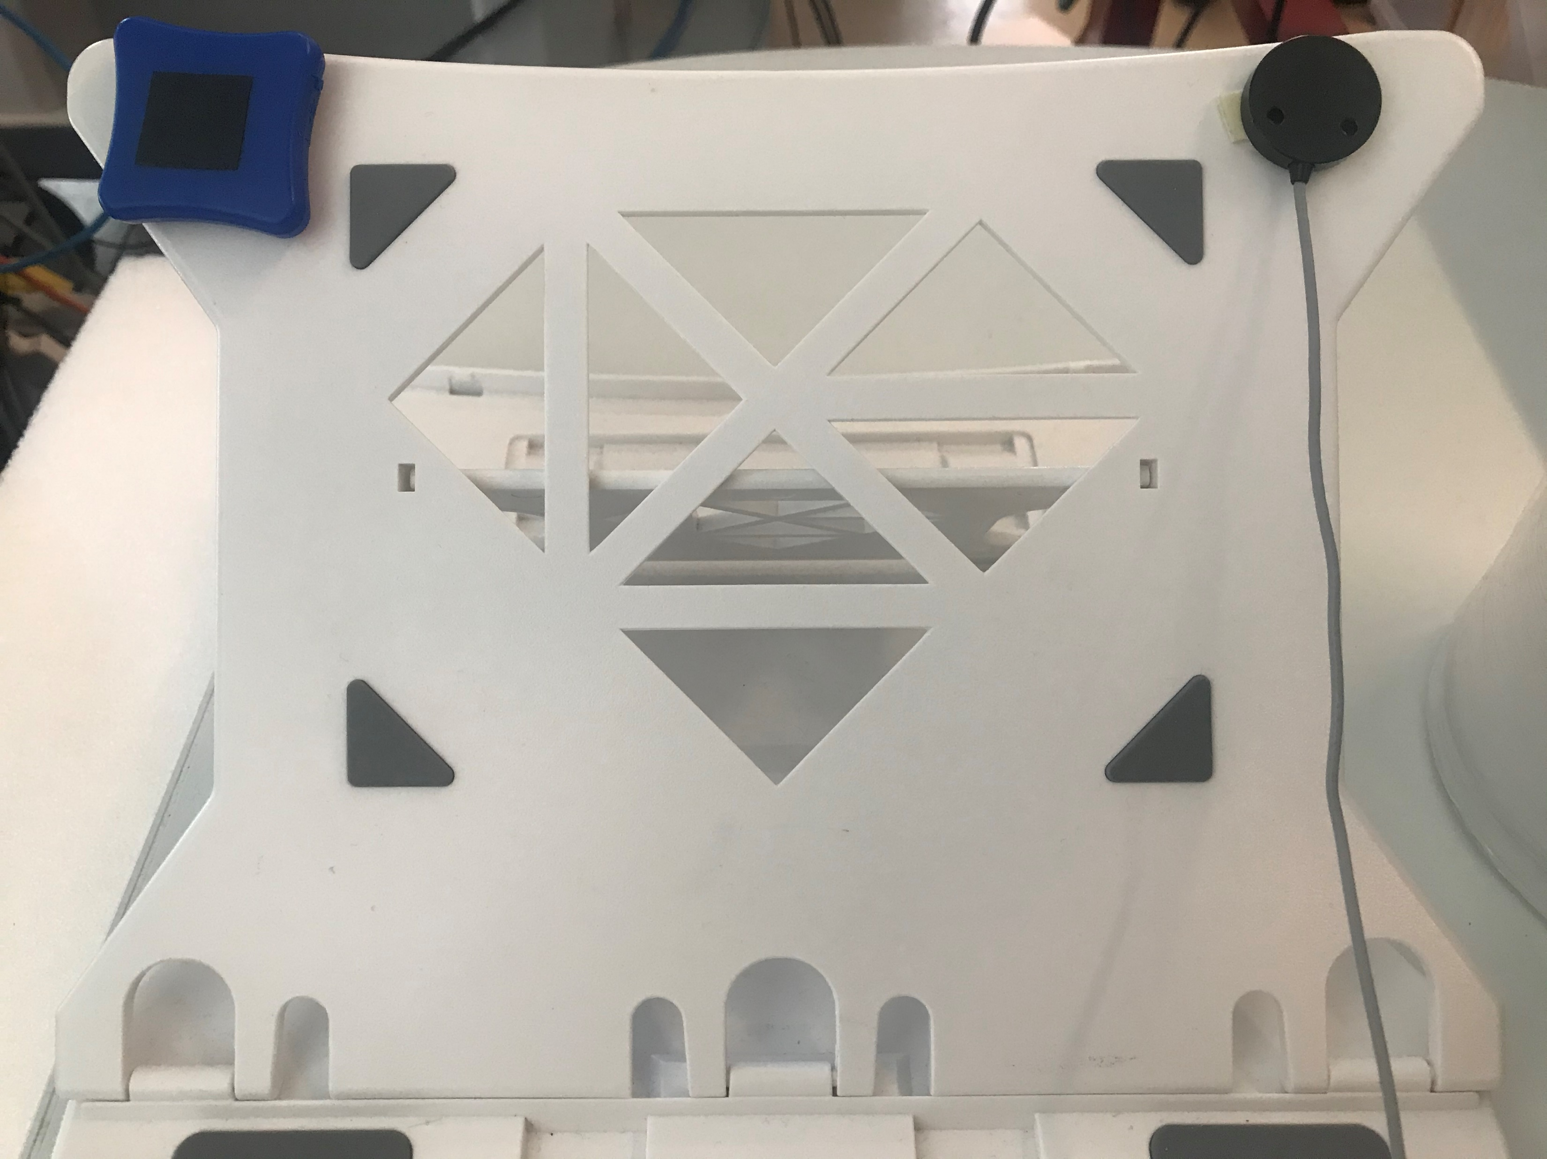
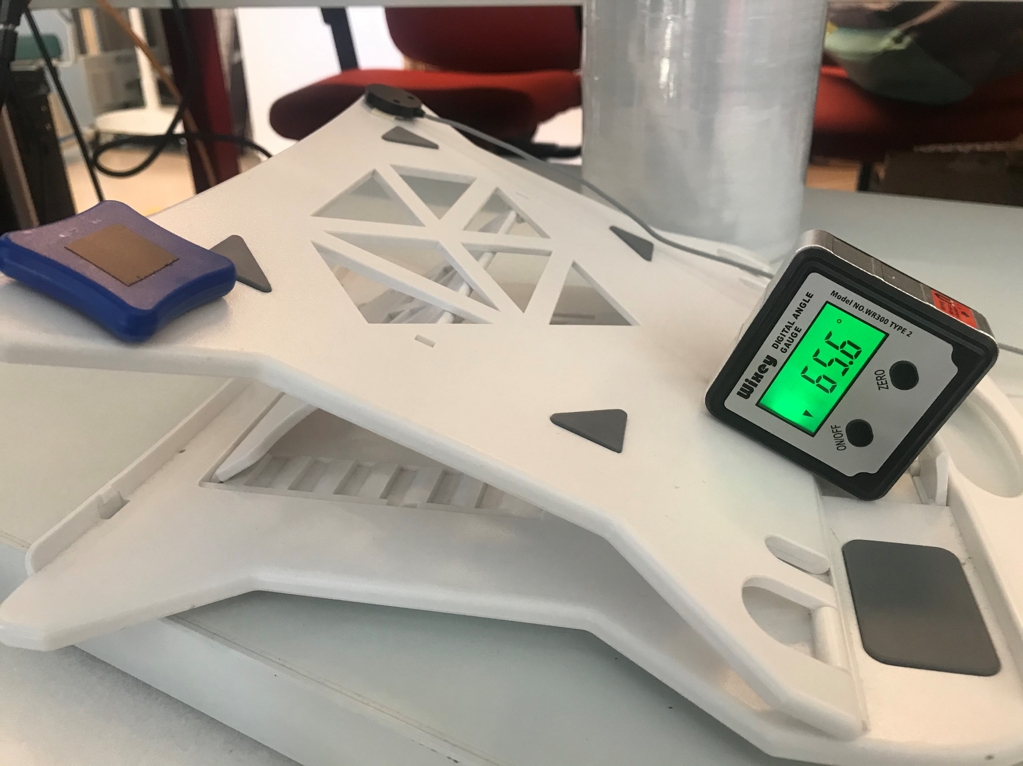
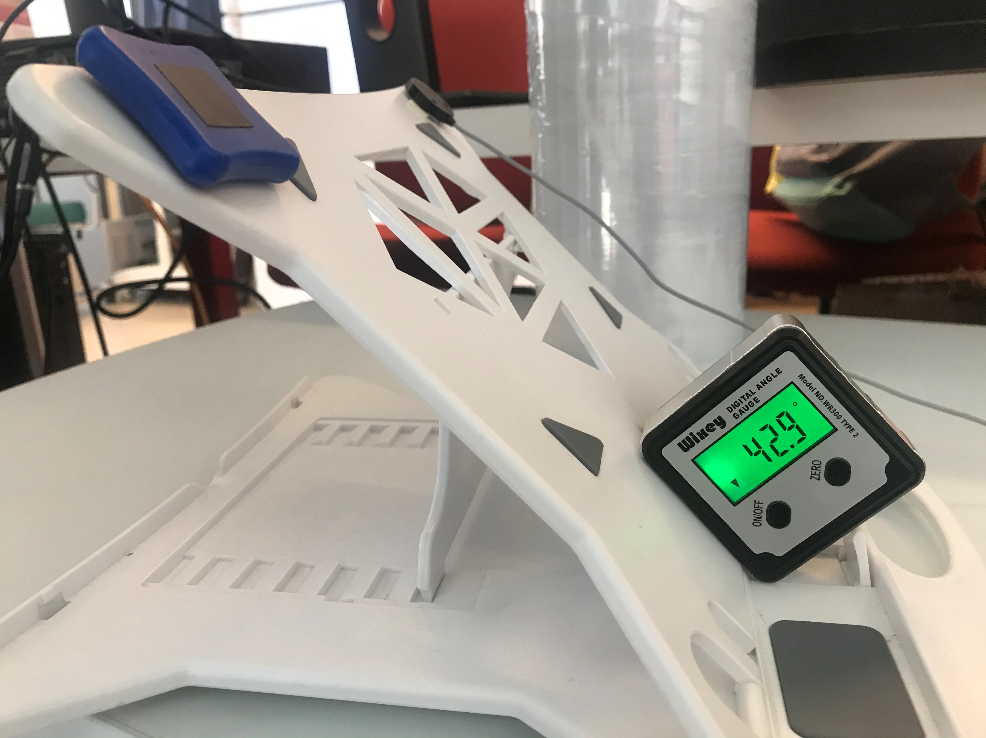
Calibration setup
IMUs
EM tracker
Laptop Stand

Slide 4
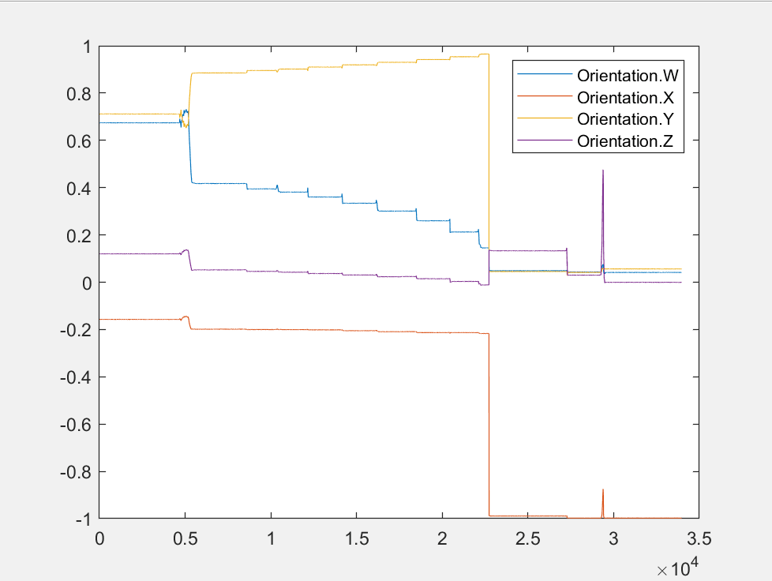
Calibration Data
The measurement result from IMU (after calculated from quaternion )
3.8791
15.3880
90 - 62.3222 = 27.6778
90 - 56.5900 = 33.41
90- 51.5817 = 38.4184
90 - 47.4800 = 42.52
90 - 44.1791 = 45.8209
90 - 41.5314 = 48.4686
90 - 39.7661 = 50.2339
90 - 36.8317= 53.1683

